Slide 2
Our nation’s freight transportation system is a vast, complex network of almost seven million miles of highways and local roads, railways, navigable waterways, and pipelines.

Slide 3
Our freight system is more than just infrastructure…
2.5 million combination trucks; millions of single unit trucks and vans; 24,000 diesel-electric locomotives; 1.28 million freight rail cars; 38,600 domestic maritime vessels; and 700 domestic all-cargo aircraft all operate in this system.
3.1 million Americans are employed in operating and supporting freight vehicles, as well as in logistics.
44 million jobs directly depend on freight transportation.

Slide 4
Freight transportation makes our economy and quality of life possible.
Each day, our freight system transports 55 million tons of goods, worth more than $49 billion.
Notes:
Over the course of a year, that is over 63 tons for each one of us.

Slide 5
Our freight transportation is safer, more environmentally friendly, and imposes fewer adverse impacts on most communities today than in past decades.
Even so, increasing challenges have placed our freight system under serious strain.
The National Freight Strategic Plan (NFSP) discusses six major trends affecting freight transportation and the challenges they present.

Slide 6
Six Key Trends and Challenges in Freight Transportation
Expected Growth in Freight Tonnage
Underinvestment in the Freight System
Difficulty in Planning and Implementing Freight Projects
Continued Need to Address Safety, Security, and Resilience
Increased Global Economic Competition
Application and Deployment of New Technologies

Slide 7
Expected Growth in Freight Tonnage

Slide 8
Underinvestment in the Freight System

Slide 9
Underinvestment in the Freight System
Due primarily to retirement and turnover, employers will need to hire and train a total of 4.6 million employees—like truck drivers and maintenance technicians—from 2012 to 2022.
There are 68% more job openings than the number of students entering the workforce.
Notes:
Annual job openings are 68% larger than the number of students who are completing educational programs for selected transportation occupations.

Slide 10
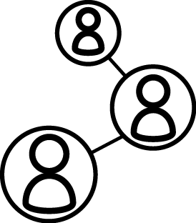
Difficulty in Planning & Implementing Projects
Most of our publicly owned freight system is planned and managed by State and local governments, as well as by Metropolitan Planning Organizations (MPOs).
These agencies must work with each other and a broad array of Federal and private sector partners.

Slide 11
Difficulty in Planning & Implementing Projects
This decentralized approach has many benefits, including greater flexibility to identify and react to local needs….
But, this approach presents a number of challenges, including:
Fragmented decision-making.
Competing local and regional needs.
Freight projects that are often less competitive for funding when compared to more traditional projects.

Slide 12
Need to Address Safety, Security, & Resilience
27% increase in freight ton-miles
33% decrease in freight-related fatalities
Between 1990
and 2011…
However, more progress must be made. In 2013,
543 people died in incidents associated with freight rail, vessel, and pipeline operations.
3,964 people were killed in crashes involving large trucks.

Slide 13
Need to Address Safety, Security, & Resilience
Notes:
Note that all transportation is the second leading source of GHG, not just freight transportation.

Slide 14
Need to Address Safety, Security, & Resilience
Since 9/11, freight movements to ports have been increasingly inspected. But, new technologies are creating new vulnerabilities…
New security protocols should not exacerbate other issues affecting the efficiency of freight flows.
Increasing interdependencies between physical and cyber infrastructures make our freight transportation system particularly vulnerable to human-engineered events of terrorism.

Slide 15
Increased Global Economic Competition
Notes:
Note also the value of international freight will more than triple (the volume of freight by tonnage will more than double) between 2040 and 2012.

Slide 16
Increased Global Economic Competition
With growing international trade and shifting trade patterns, our freight system is becoming more complex and sophisticated. Ports are becoming increasingly automated.
There are signs offshoring is slowing or reversing. Since 2010, more than 200 companies have brought back production they had sent out of the country.
Changing and shifting international trade environments could have ramifications in the U.S. The expansion of the Panama Canal and economic growth in South Asia and Africa may lead to increased traffic at some Gulf and East Coast ports.

Slide 17
Application and Deployment of New Technologies
The freight industry is experiencing a technological revolution as information and communications technologies are applied to optimize global supply chains. We foresee:
Better data collection and analysis capabilities.
Growth in autonomous vehicle technologies.
Automated and expedited inspection processes.
New opportunities and challenges to improve safety and security.

Slide 18
Strategies
The NFSP presents solutions and strategies to address the infrastructure, institutional, and financial bottlenecks that hinder the safe and efficient movement of goods.

Slide 19
Infrastructure Bottlenecks
Infrastructure bottlenecks are physical locations that disrupt the free flow of goods, including:
Bridges,
Border crossing facilities,
At-grade railroad crossings, and
Truck gates at ports.

Slide 20
Infrastructure Strategies
Reduce congestion to improve performance.
Improve the safety, security, and resilience of the freight transportation system.
Facilitate intermodal connectivity.
Identify major trade gateways and multimodal national freight networks/corridors.
Mitigate impacts of freight projects/movements on communities.
Support research and promote adoption of new technologies and best practices.

Slide 21
Institutional Bottlenecks
Institutional bottlenecks make it difficult to plan, prioritize, implement, and fund freight projects. U.S. DOT and its many partners each have processes in place to plan for, review, permit, and implement transportation projects.
Stakeholders may have different capabilities, priorities, and objectives that must be reconciled to effectively plan and implement projects.

Slide 22
Institutional Strategies
Streamline project planning, review, permitting, and approvals.
Facilitate multijurisdictional, multimodal collaboration and solutions.
Improve coordination between public and private sectors.
Ensure availability of better data and models.
Develop the next generation freight transportation workforce.

Slide 23
Financial Bottlenecks
It is critical to establish Federal freight transportation funding that is substantial, continuing, multimodal, reliable, and specifically dedicated to freight transportation projects.
The availability of such funds would assure States, MPOs, and local governments that major freight transportation projects could be funded and completed.

Slide 24
Financial Strategies
Ensure dedicated freight funding.
Use existing grant programs to support freight.
TIGER program
Build America Transportation Investment Center (BATIC)

Slide 25
Multimodal Freight Network Map
To develop a sound and effective national freight strategy, we need to be mindful of the freight facilities, networks, and trade gateways that are critical for freight movement across the nation.
The proposed Multimodal Freight Network (MFN) map informs planners, private sector stakeholders, and the public about where major freight flows occur and where special attention to freight issues may be most warranted.

Slide 26
The MFN map contains…
65,000 miles of highways, including the entire Interstate System.
49,900 miles of the highest volume Class I rail routes and the full strategic rail corridor network (STRACNET).
America’s Marine Highway routes.
78 ports that collectively handle 90 percent of the nation’s waterborne container and bulk cargo movements.
56 airports that handle approximately 90 percent of the nation’s air cargo.
The 75 largest highway-rail intermodal transfer facilities by volume.

Slide 27
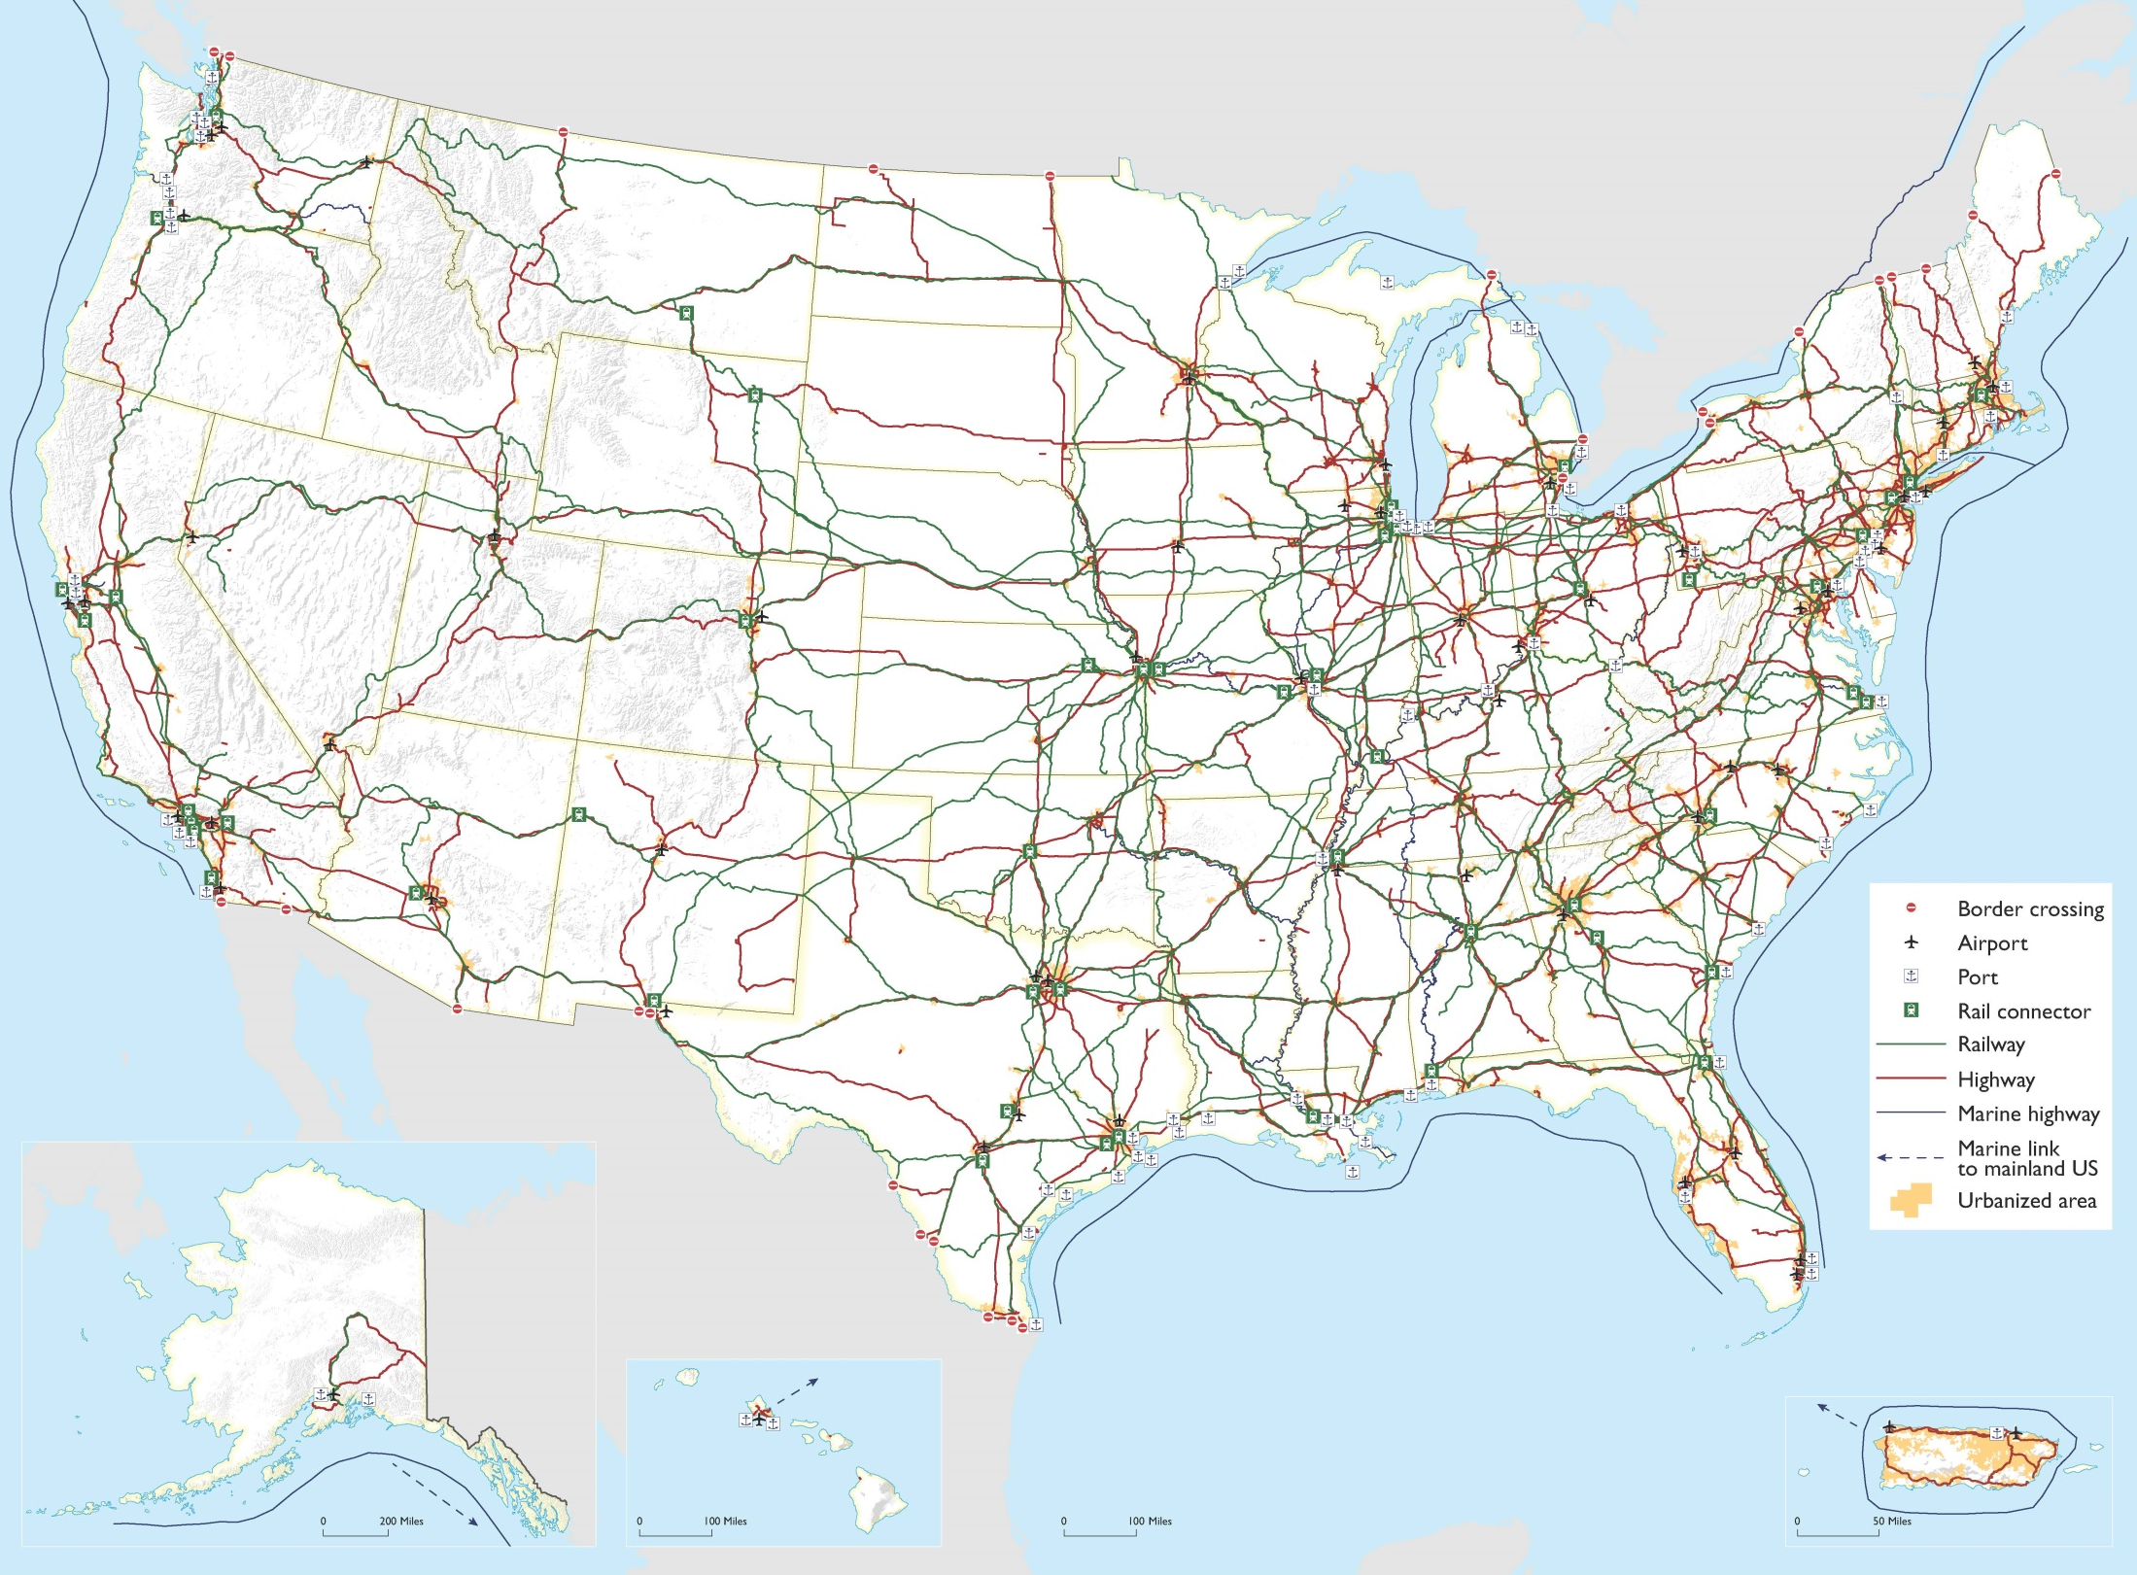
MFN Map

Slide 28
U.S. DOT is accepting comments on the Draft National Freight Strategic Plan. Share your ideas at:
www.transportation.gov/freight

